Slide 1






Slide 2


Ambassador Training
E-PLEDGE

Slide 3


M-DCPS on the Frontlines
As part of the Miami-Dade County Public Schools (M-DCPS) family, you’re on the frontlines of helping to educate our children.
We appreciate you and all that you are doing for our community. Your strength is helping us build a stronger Miami

Slide 4

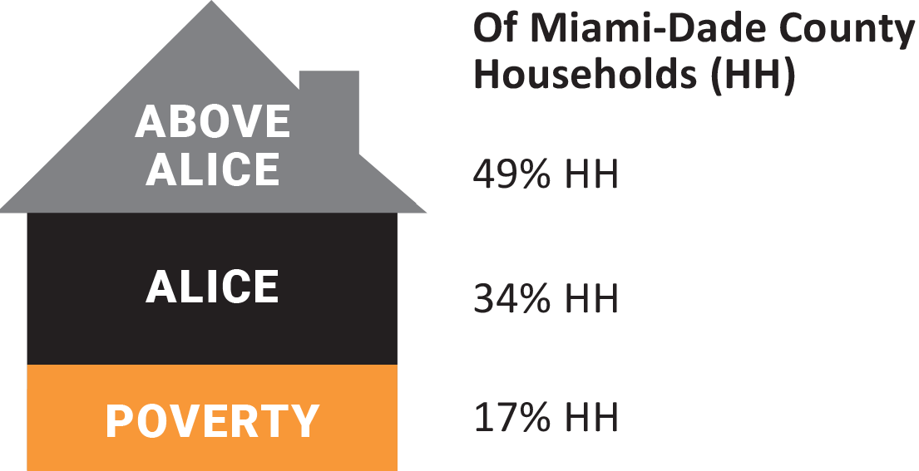
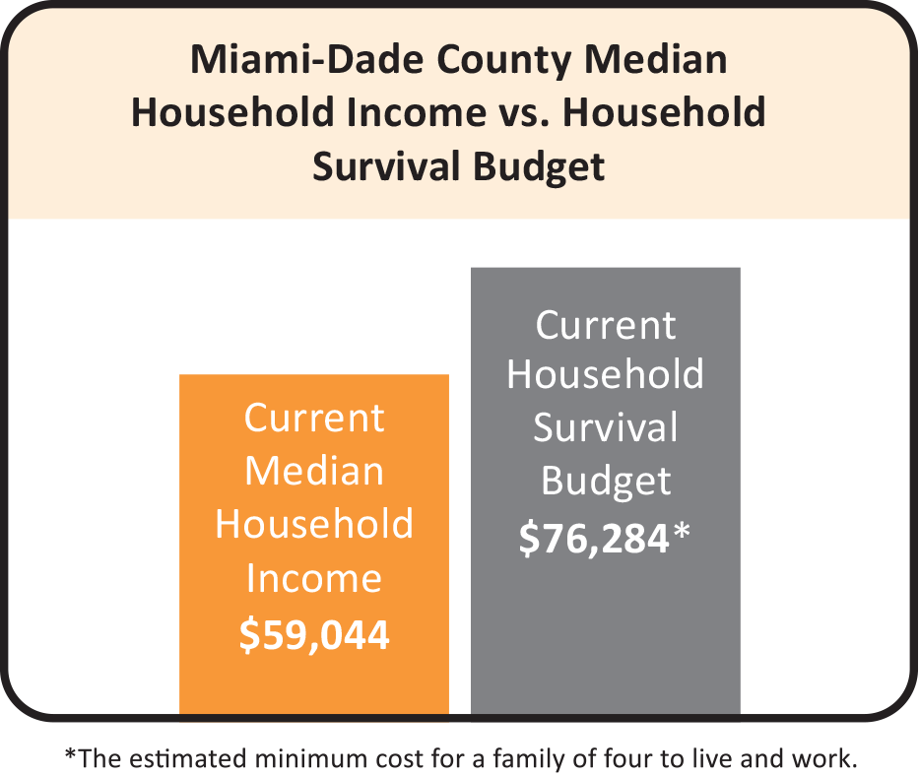
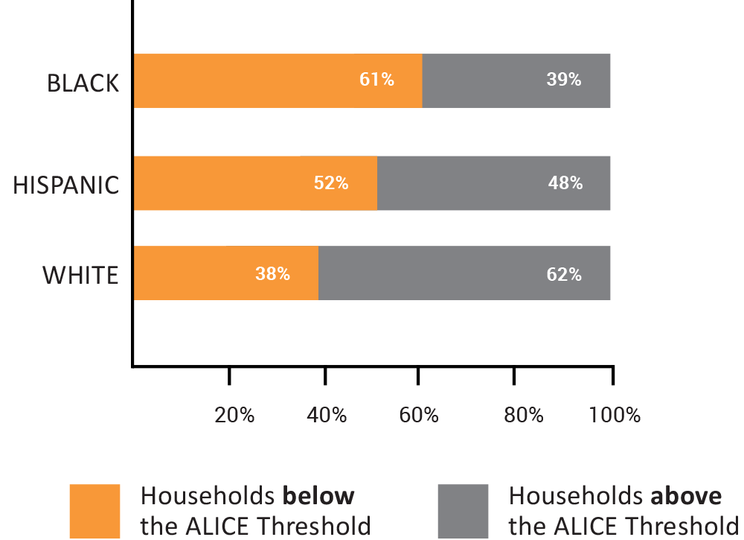
ALICE
These are the individuals and families that most of your gifts help.

Slide 5

Ambassador Roles
United Way Ambassadors should be appointed from each work location by the Principle or Head Administrator and will be responsible for carrying out the 2023-2024 UW Employee or Student Campaign at their location.
  All work locations will have assigned at least one Employee Ambassador, one Student Ambassador and one ePledge Ambassador
    ePledge Ambassadors: cannot hold the position of student and employee ambassador
      Responsible for inputting data and providing reports

Slide 6
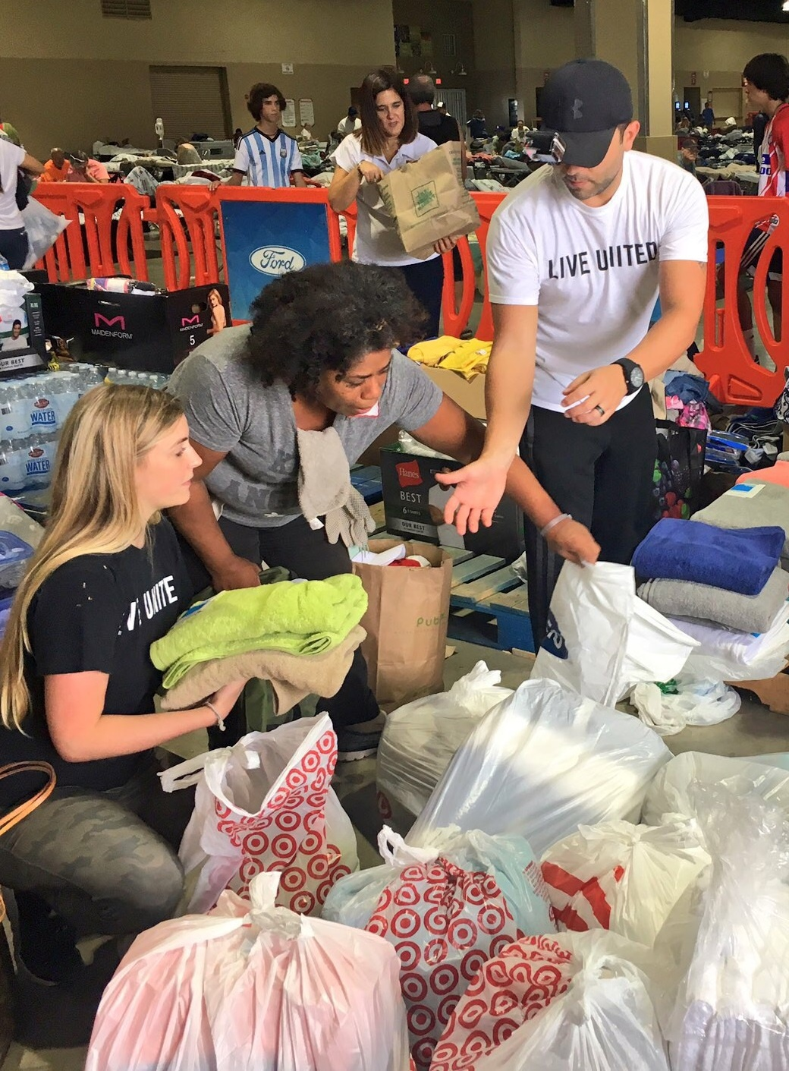
E-PLEDGE Ambassador

Slide 7
ePledge Ambassador Responsibilities
The ePledge Ambassador is typically someone who handles money and can view sensitive information such as employee donations.
They work directly with the Employee Ambassador and Student Ambassador in entering benchmarks, goals met, confirming check and cash donations and printing reports
  ePledge Ambassadors will be entering data into the ePledge site and providing reports to the Ambassadors.

Slide 8
ePledge Ambassador Responsibilities
How to enter employee pledge (only enter a pledge if you have the employee’s physical pledge form):
Click on ePledge Administrator tab located at the bottom left of the screen.
Click on Employee Search.
Search by employee name or employee ID.
Enter the employee first and last name or employee ID.
Click on Add Pledge.
Indicate if you’re updating the pledge or if this is a new pledge.
Proceed to enter the pledge information for the employee.
Click on the “Submit” button.
A confirmation email will be sent to the employee for their records and tax purposes.

Slide 9
ePledge Ambassador Responsibilities
How to enter Student 1st Benchmark report:
Click on the ePledge Administrator tab located at the bottom left of the screen.
Click on Student Campaign 1st Benchmark form button.
Enter the information requested.
Include the total amount raised to date.
Click on the “Submit” button.
How to access Employee donation reports:
Click on the ePledge Administrator tab located at the bottom left of the screen.
Click on Transaction Details.
Click on Export All Details to Excel.

Slide 10
ePledge Ambassador Responsibilities
How to access & finalize Employee Transmittal Form for Employee Campaign:
Click on ePledge Administrator tab located at the bottom left of the screen.
Click on Employee Transmittal Form button.
Print and completely fill out all information on the form.
When the form is accurate, have the Employee Ambassador and the Principal/Head Administrator sign.
Keep a copy of the Transmittal Form with signatures for your records. The Employee Ambassador should also keep a copy of the form for their records.
The original form should be submitted by the Employee Ambassador to United Way Miami along with any checks and paper pledge forms in the Employee envelope.
How to access & finalize Final Report for Student Campaign:
Click on ePledge Administrator tab located at the bottom left of the screen.
Click on Student Final Report button.
Include the total amount raised.
Click on the “Submit” button.
Make copies of the submitted form. Keep a copy of the Final Report with signatures for school records and give a copy to the Student Ambassador for their records.
The original should be submitted with all appropriate signatures to United Way in the Student envelope along with any checks.

Slide 11
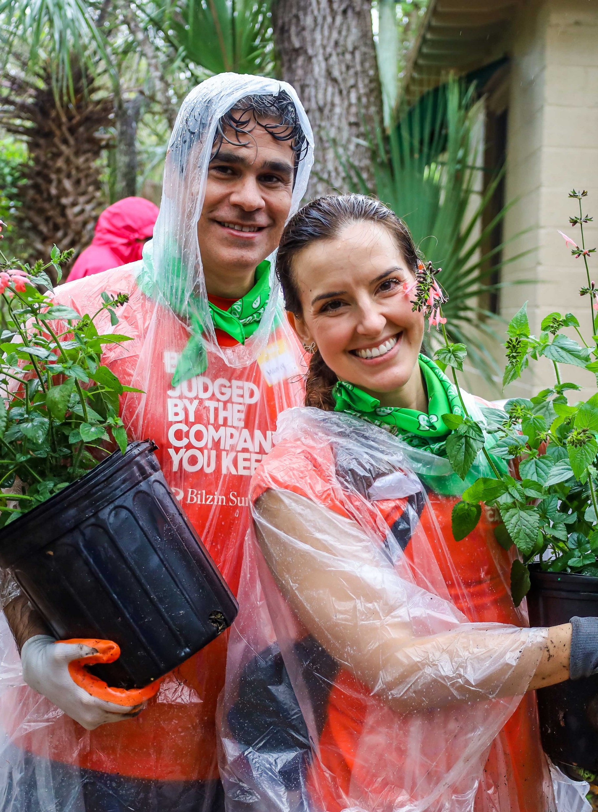
Important Dates to Remember for the Employee Campaign
  OCTOBER 2nd - CAMPAIGN STARTS
    Make sure to do check ins through out the campaign to make sure everyone is engaged
  OCTOBER 9th - Last day to submit request for goal adjustment to Ines Meras imeras@dadeschools.net or Shaquellia M. Holmes dadepartners@dadeschools.net
  OCTOBER 31st & NOVEMBER 7th -Ask ePledge Ambassador to print an all-employees report. Follow up with colleagues who have not submitted a donation yet
  NOVEMBER 15th - CAMPAIGN ENDS
  NOVEMBER 16-17TH – Complete final report and place campaign package in school mail
    Make sure to make a copy of the forms
    Submit the original with two signatures and the final check for funds raised in the Employee envelope
  NOVEMBER 20-22nd – Hand deliver campaign packages to United Way Miami (3250 SW 3RD Avenue Miami, Fl. 33129)

Slide 12
Important Dates to Remember for the Student Campaign
  OCTOBER 2ND - CAMPAIGN STARTS
  OCTOBER 9TH - Last day to submit request for goal adjustment to Ines Meras imeras@dadeschools.net or Shaquellia M. Holmes dadepartners@dadeschools.net
  OCTOBER 16TH - 1st STUDENT BENCHMARK DUE
    E-Pledge ambassador inputs the total amount raised for the campaign via ePledge
    If money has not been raised at this point – please still enter $0 as submission
  NOVEMBER 15TH - CAMPAIGN ENDS
  NOVEMBER 16-17TH - Complete final report and place student campaign package in school mail
    Make sure to make a copy of the forms
    Submit the original with two signatures and the final check for funds raised in the Student envelope
  NOVEMBER 20-22 - Hand deliver campaign packages to United Way Miami (3250 SW 3RD Avenue Miami, Fl. 33129)

Slide 13
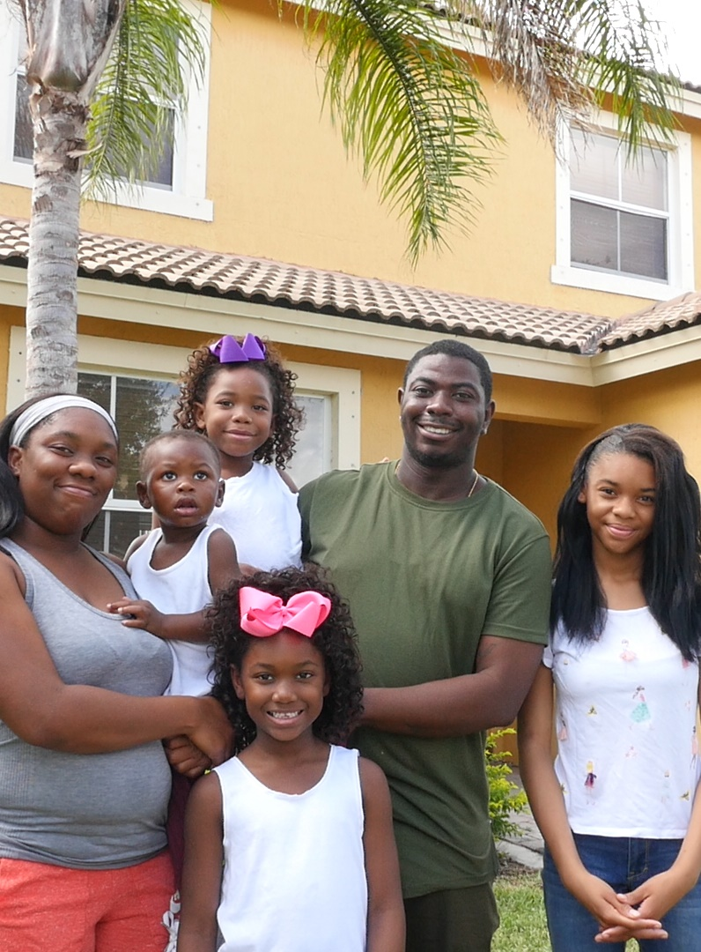
Instructions for completing Employee Transmittal Form
The transmittal form should be downloaded via ePledge.
The ePledge Ambassador will print the transmittal form from the ePledge site.
The form should be populated manually, reviewed, any incomplete or missing information added and signed by both the Employee Ambassador and the Principal/Head Administrator.
The Employee Ambassador will place the transmittal form with original signatures in the Employee envelope along with checks and any other related campaign materials. Make two copies, one for the school and the other for the Employee Ambassador’s records.
Mail the envelope through the school mailing system that will be delivered to United Way Miami (Work Location: 9601).
Check list for Employee envelope:
Original signed transmittal form
Checks (personal)
Check for special events
Check/money order from cash (do not mail cash)
Pledge forms separated by payment

Slide 14
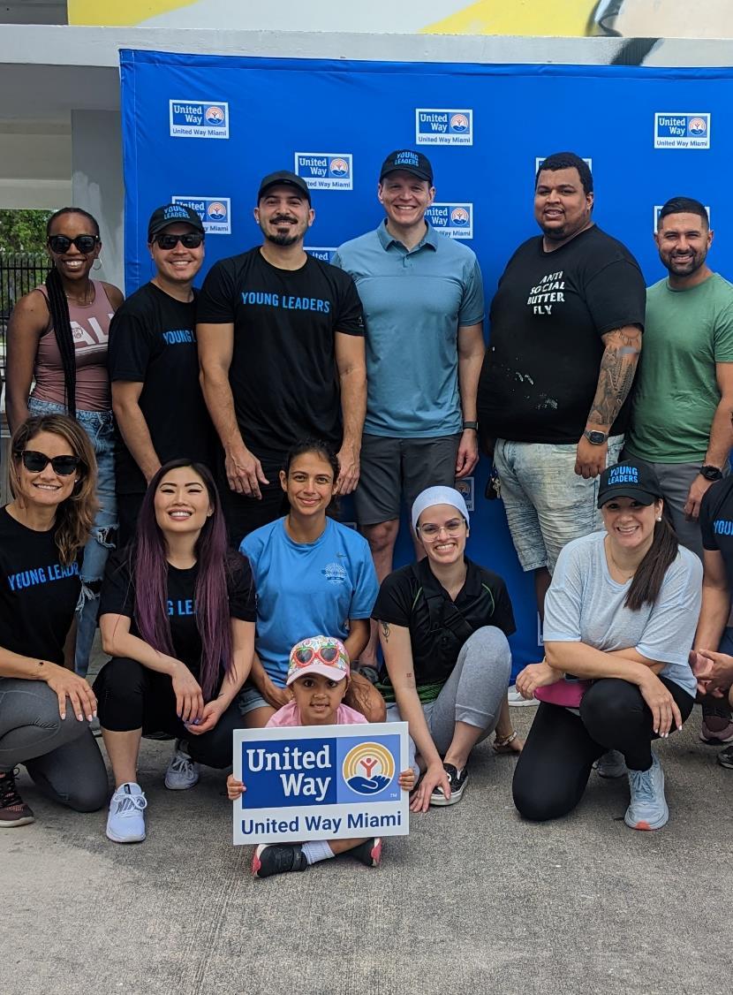
Campaign Toolkit
United Way of Miami-Dade (engagemiamidade.net)
  This toolkit provides different ways to get involved with the campaign, what your gift does and a plethora of resources such as our community partners, forms for the campaign, aid, volunteer events and events we have celebrating our 100 years!

Slide 15
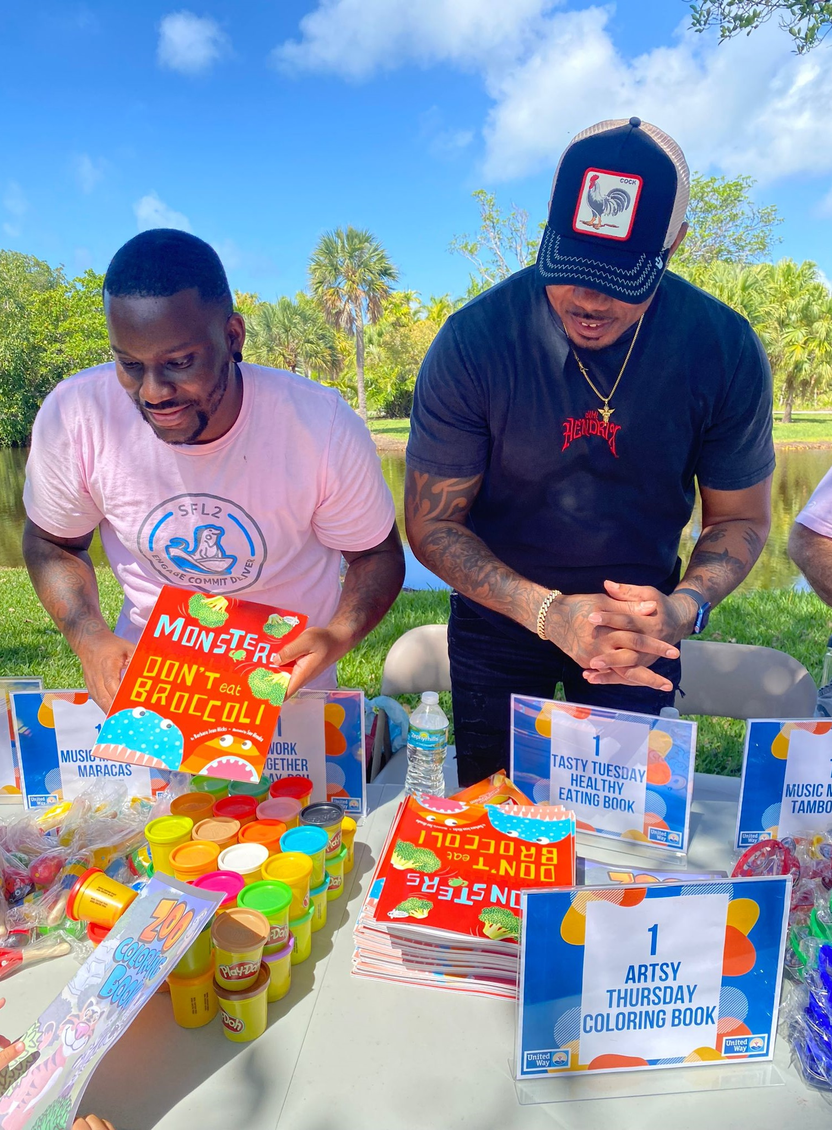



Accountable
  Administrative costs well below the Better Business Bureau’s benchmarks
  Wise Giving Alliance – ratio of funding to costs: Excellent
  Charity Navigator: 4 out of 4 Stars

Slide 16

Contact Us
Please encourage employees to utilize the Contact Us tab in the ePledge system if they have a question. In addition, employees can utilize the contact information below.
Questions about the campaign? Need more supplies or to schedule presentations?
Please contact (305) 646-7133 or mdcps-epledge@unitedwaymiami.org

Slide 17




(Company logo here)

Slide 18


